Slide 1

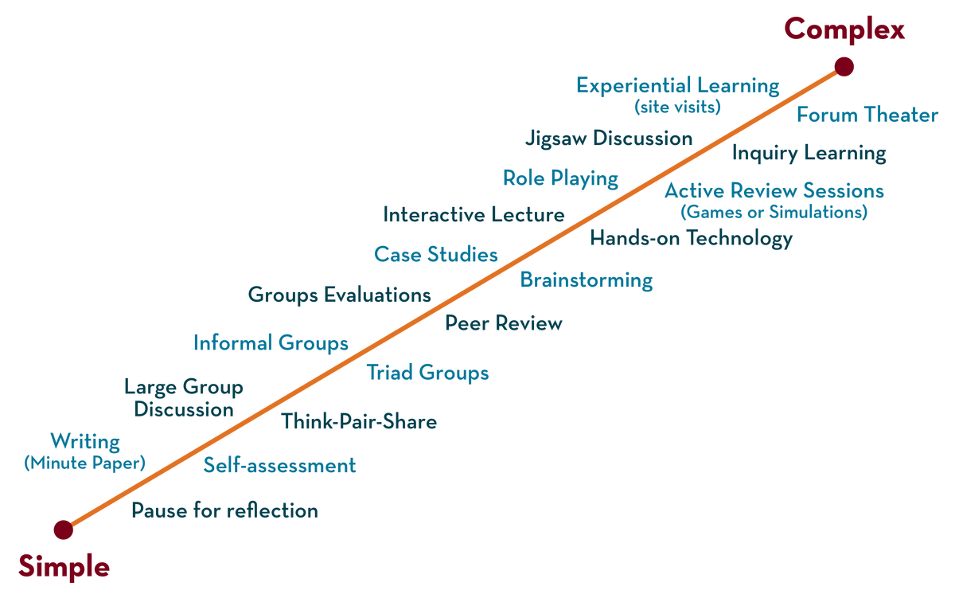
Department of CSE
Deep Learning
20CS3269AA
Topic:
Momentum based
Gradien descent
Session - 7

Slide 2



AIM OF THE SESSION
To familiarize students with the concept of Gradient Descent (GD)
INSTRUCTIONAL OBJECTIVES
This Session is designed to:
Demonstrate the momentum based Gradient Descent (MGD)
LEARNING OUTCOMES
At the end of this session, you should be able to:
Able to apply momentum based Gradient Descent (MGD) for optimization

Slide 3
Index
SESSION Introduction
The topics covered in the session are
Why we need
Momentum based Gradient Descent
Algorithm
Simple problem with momentum based GD
03/12/2024
Deep learning
<number>

Slide 4
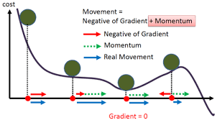
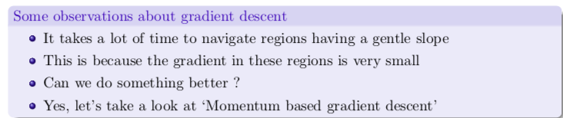
Drawbacks of GD –why we need momentum GD
Suppose if we have millions of records then training becomes slow and computationally very expensive in GD.
The gradient of the cost function at saddle points( plateau) is negligible or zero, which in turn leads to small or no weight updates
Hence, the network becomes stagnant, and learning stops
03/12/2024
Deep learning

Slide 5
Gradient Descent with Momentum
Momentum is an extension to the gradient descent optimization algorithm, often referred to as gradient descent with momentum.
It takes small steps in directions where the gradients oscillate and take large steps along the direction where the past gradients have the same direction(same sign).
It is designed to accelerate the optimization process, e.g. decrease the number of function evaluations required to reach the optima,
to improve the capability of the optimization algorithm, e.g. result in a better final result
03/12/2024
Deep learning
<number>

Slide 6
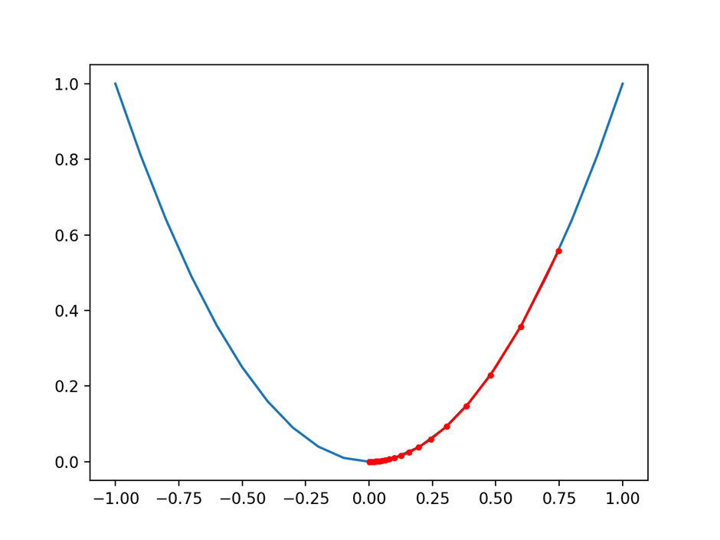
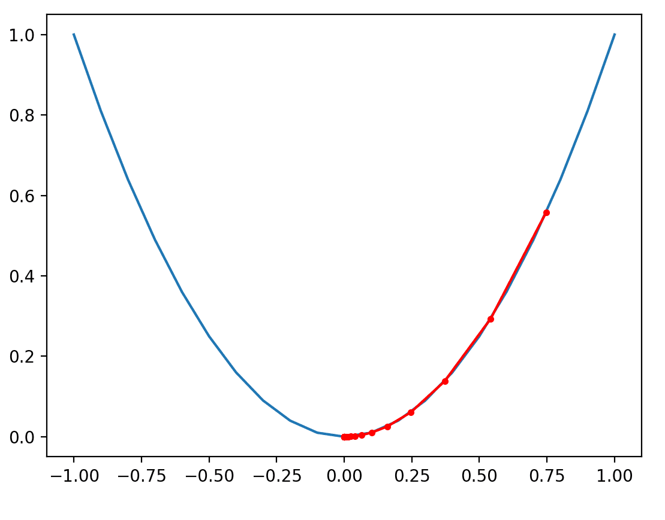
Gradient Decent
Momentum GD
the search reaches the optima in more steps
the search reaches the optima in fewer steps, noted with fewer distinct red dots on the path to the bottom of the basin.
03/12/2024
Deep learning
<number>

Slide 7
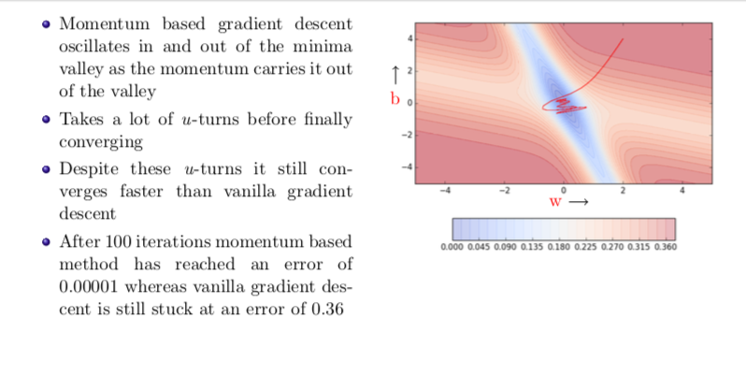
Momentum based Gradient Descent (Cont..)
03/12/2024
Deep learning
<number>

Slide 8
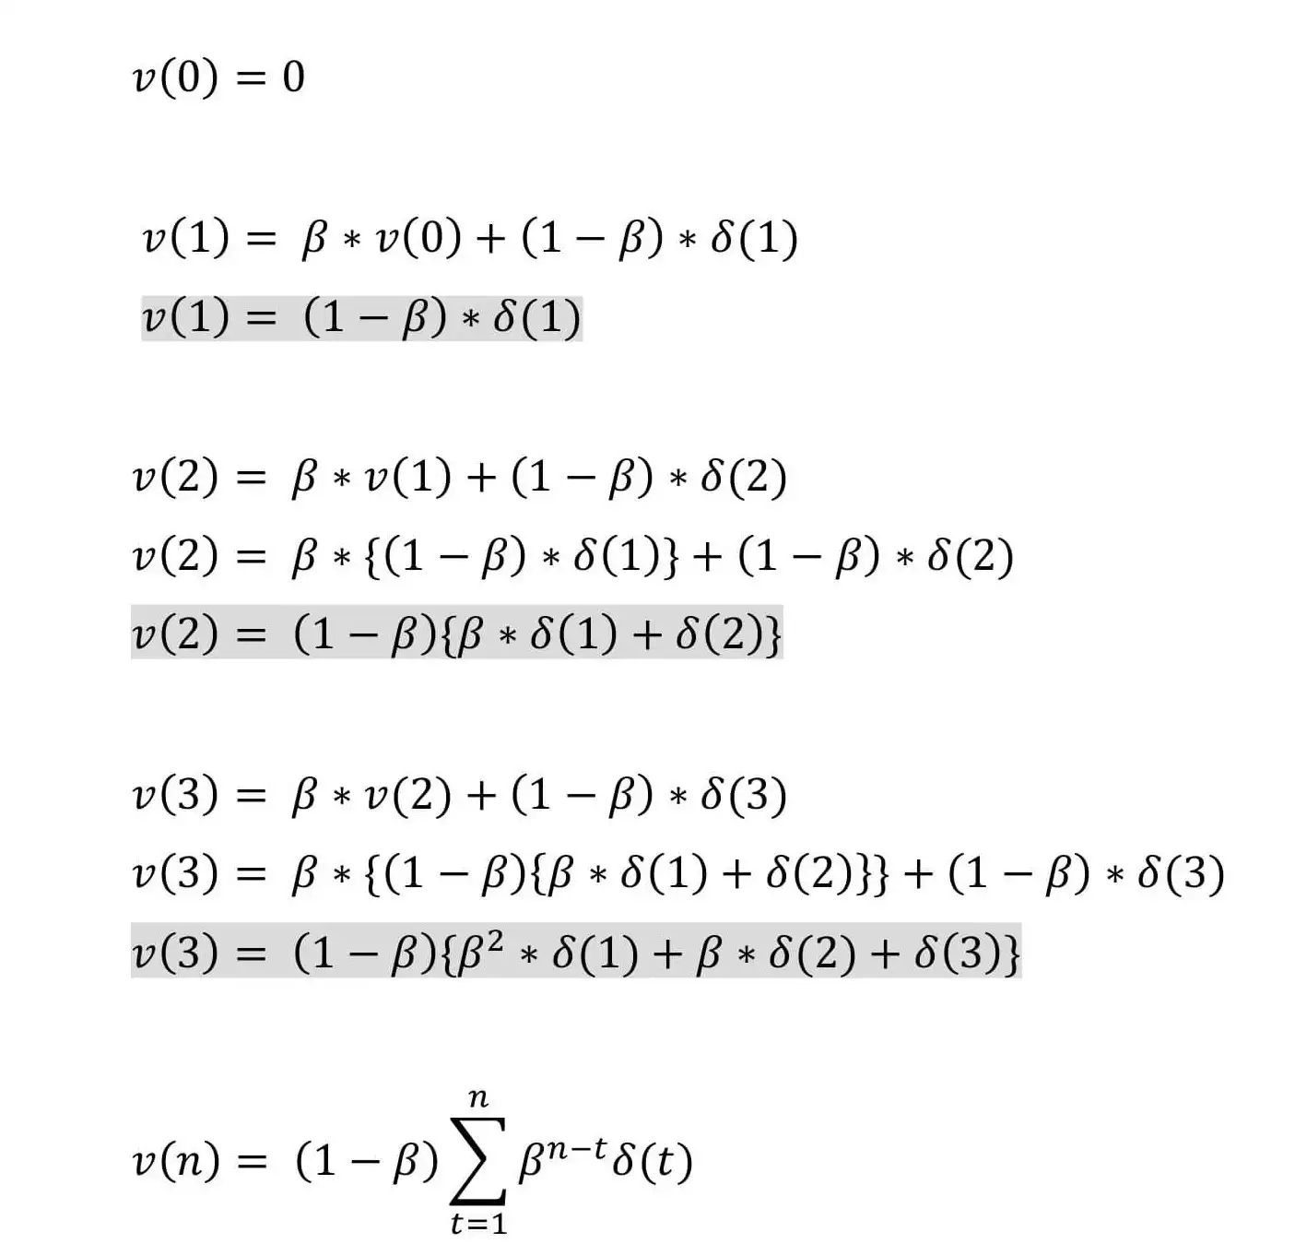
Momentum based Gradient Descent (Cont..)
Update rule:
Where
𝓥(t): is the new weight update done at iteration t
β: Momentum constant
𝛿(t): is the gradient at iteration t
03/12/2024
Deep learning
<number>
Notes:
If the value of the beta is 0.5 then it means that the 1/1–0.5 = 2 so it represents that the calculated average was from the previous 2 readings.
Local minima can be an escape and reach global minima due to the momentum involved.
<number>

Slide 9
SESSION DESCRIPTION
The momentum (beta) must be higher to smooth out the update because we give more weight to the past gradients.
Using the default value for β = 0.9 is suggested but can be tuned between 0.8 to 0.999 if needed.
Momentum takes into account past gradients so as to smooth down gradient measures.
It can be implemented with descent by batch gradient, descent by mini-batch gradient or descent by stochastic gradient.
03/12/2024
Deep learning
<number>

Slide 10
MBGD with minibatch
It is a common practise to use batch sizes as powers of 2 to offer better runtime with certain hardware.
Small batches tend to have a regularizing effect because of the noise they inject as each update is made by seeing only a very small portion of the entire training set, a.k.a., a batch of samples.
The minibatches should be selected randomly. It is sufficient to shuffle the dataset once and iterate over it multiple times.
In the first epoch, the network sees each example for the first time and hence, the estimate of gradient is an unbiased estimate of the gradient of the true generalization error.
From the second epoch onwards, the estimate becomes biased as it is resampling from data that it has already seen
03/12/2024
Deep learning
<number>

Slide 11
Summary
Gradient descent is an optimization algorithm that uses the gradient of the objective function to navigate the search space.
Gradient descent can be accelerated by using momentum from past updates to the search position.
03/12/2024
Deep learning
<number>

Slide 12
SELF-ASSESSMENT QUESTIONS
1.Gradient Descent is an optimization algorithm used for,
A) Certain Changes in algorithm
B) minimizing the cost function in various machine learning algorithms
C) maximizing the cost function in various machine learning algorithms
D) remaining same the cost function in various machine learning algorithms
Ans: B
2._____is a type of gradient descent which processes 1 training example per iteration.
A) Batch Gradient Descent
B) Stochastic Gradient Descent
C) Mini Batch gradient descent
D) none of these
Ans: B

Slide 13
TERMINAL QUESTIONS
How does momentum work in gradient descent?
Can gradient descent with momentum overcome local minima?
Does momentum prevent Overfitting or underfitting?
03/12/2024
Deep learning
<number>

Slide 14
REFERENCES FOR FURTHER LEARNING OF THE SESSION
Books:
1 Ian Goodfellow and Yoshua Bengio and Aaron Courville (2016) Deep Learning Book
Sites and Web links:
https://shanzhenren.github.io/csci-699-replnlp-2019fall/lectures/W4-L1-Training_DNNs_I.pdf
https://medium.com/inveterate-learner/deep-learning-book-chapter-8-optimization-for-training-deep-models-part-ii-438fb4f6d135
2.
03/12/2024
Deep learning
<number>

